Slide 1
Sources, History, and the Archival Turn
Maitrii Aung-Thwin 2026
HY6101: Theory & Archive

Slide 2
"I see the time approaching when we shall base modern history, no longer on the reports even of contemporary historians, but rather on the narratives of eyewitnesses, and on genuine and original documents”.
Leopold Van Ranke 19th century (”father of ‘modern’ historical method in the West)

Slide 3
Archival Sources
Analysis
History
Conventional Knowledge Production Sequence

Slide 4
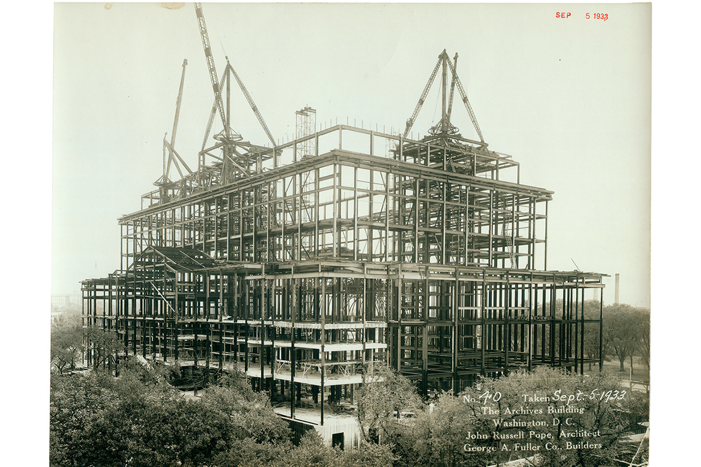
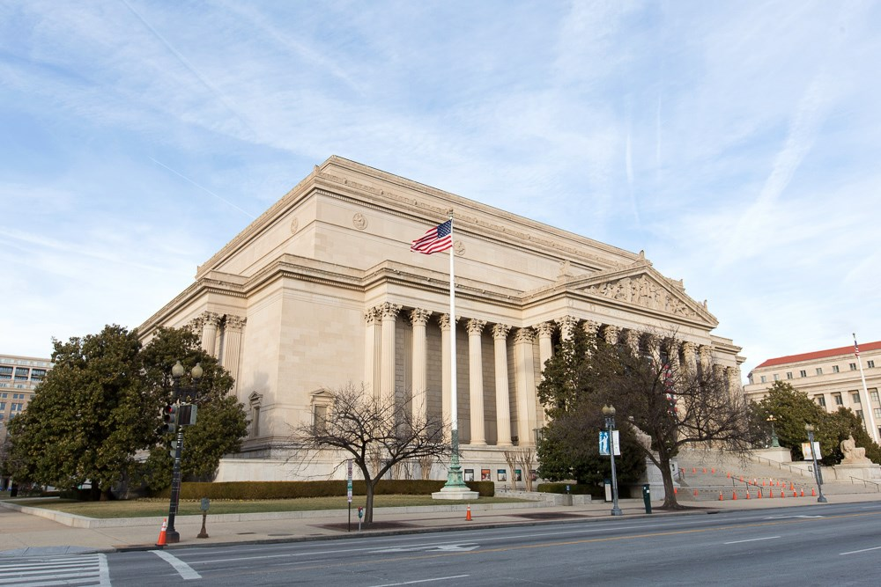
Overview
  Two perspectives of archives and their place in (historical) knowledge production
  Perspective I: Archives as repositories/sources of history
  Perspective II: Archives as an object of history, an institution that is socially “constructed”
  Perspective III: Archives as the system beneath the discourse
US Archives under construction

Slide 5
What is an archive?

Slide 6
“A collection of documents created or gathered by one person or institution and selected for long-term preservation as evidence of their activities”
-King’s College, Cambridge

Slide 7
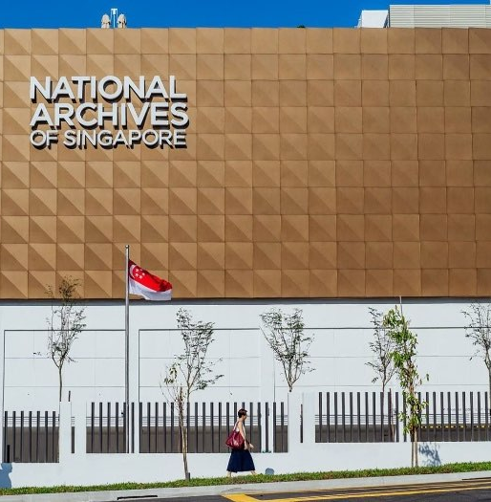
Archival Forms
A repository, a collection, a storehouse where records are preserved
A physical building, digital space where records are kept
Any papers that are old or used infrequently

Slide 8

Archives
What do archives do?
Archives register places, people, events, and social experiences
Archives record activities of social groups
Archives recover/represent worldviews, identities, agendas

Slide 9
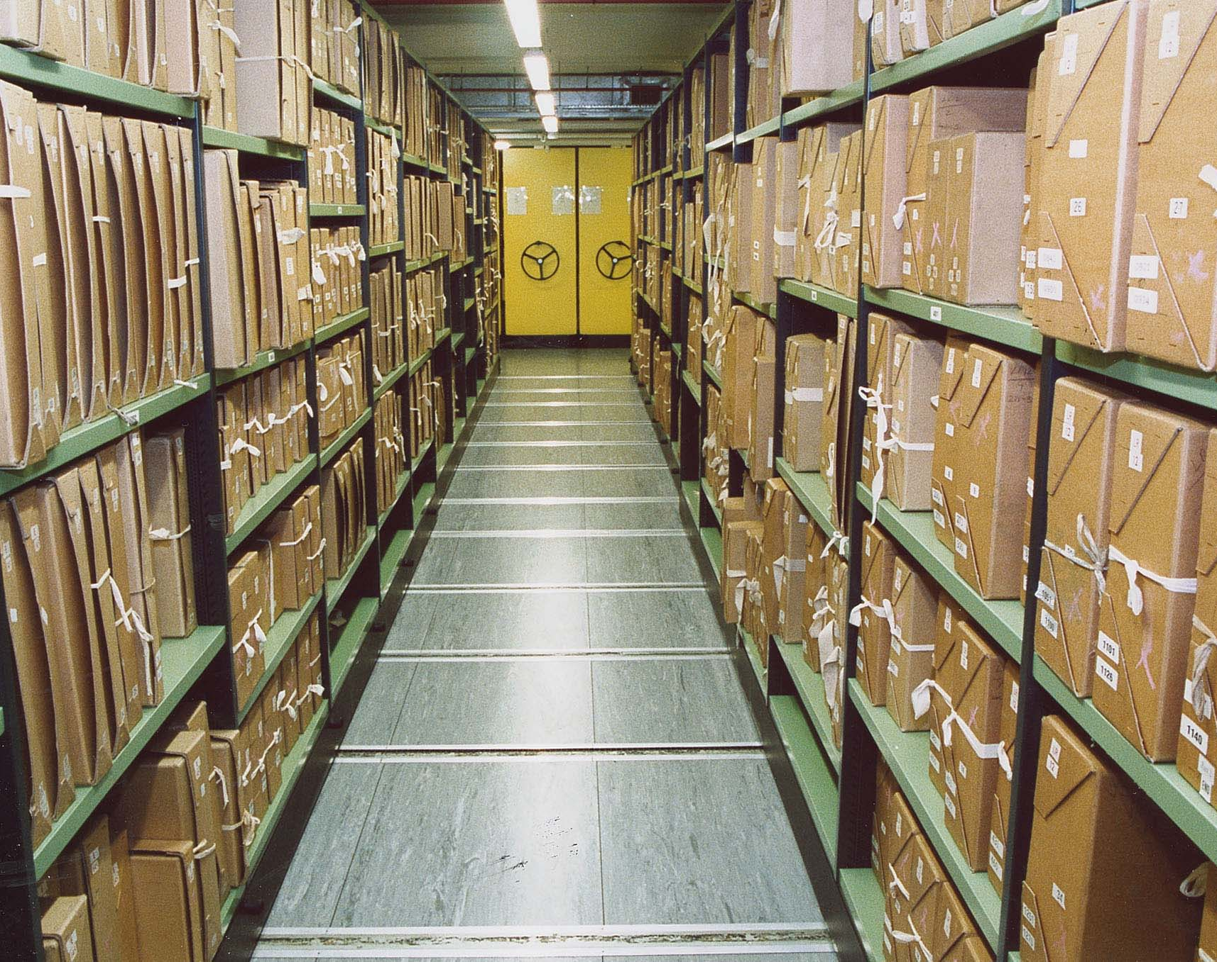
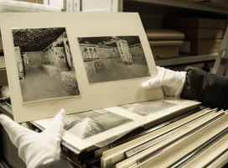
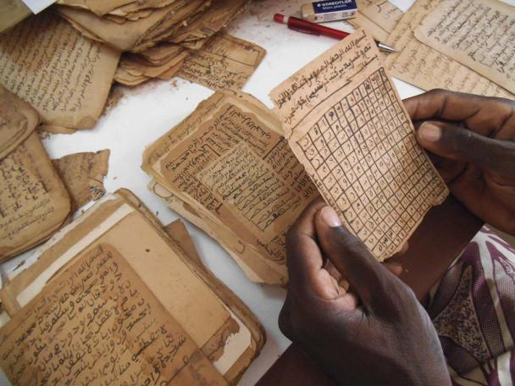
Repositories of institutions, groups, businesses, communities, nations

Slide 10
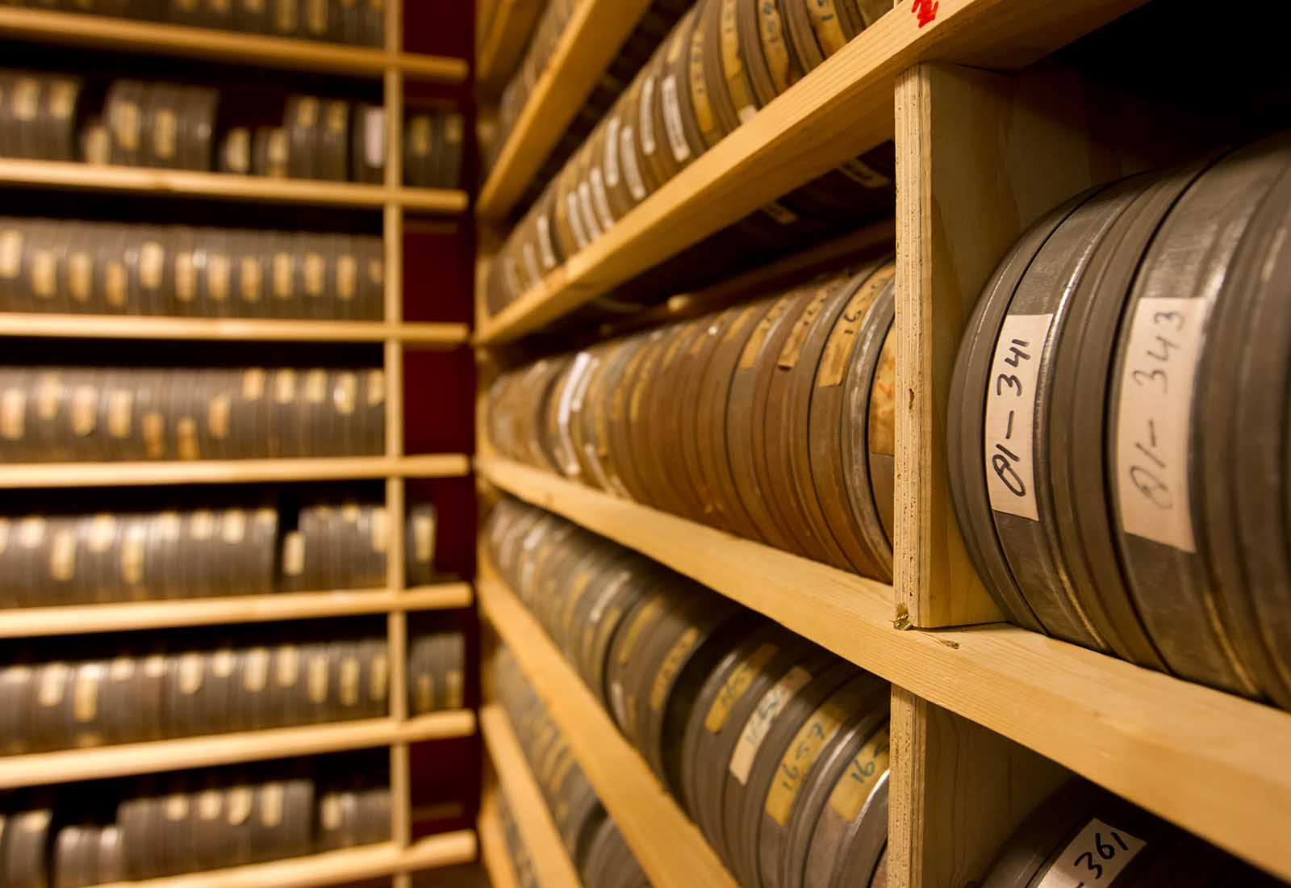
Film archive

Slide 11
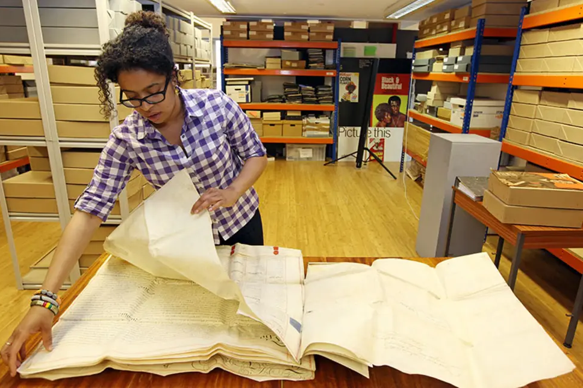
Documents

Slide 12
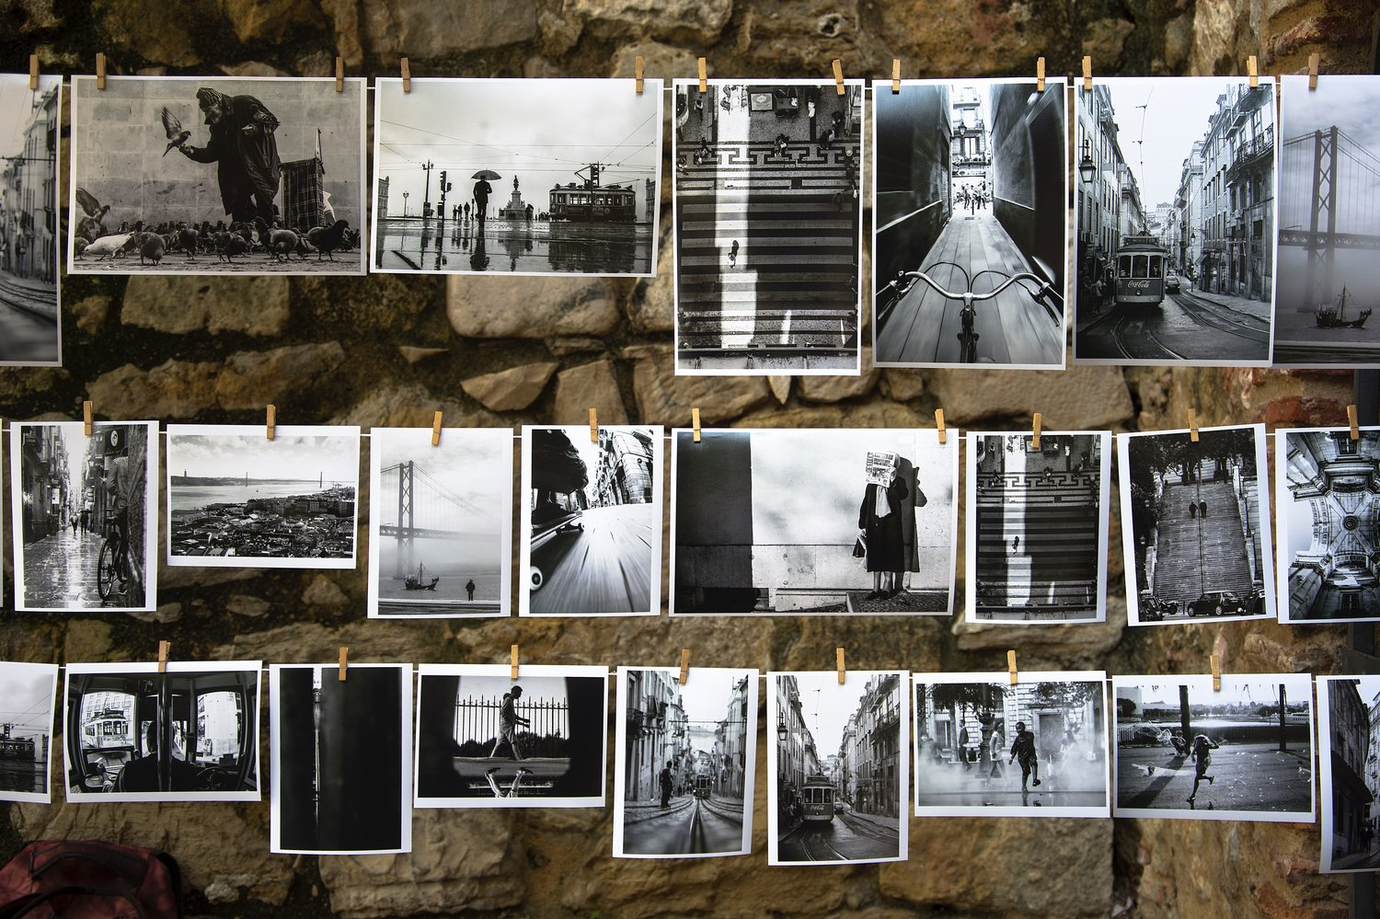
Photo archives

Slide 13
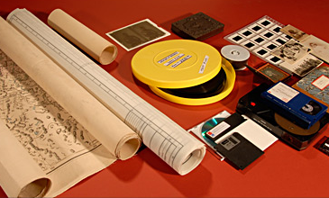
Different forms of archival materials

Slide 14
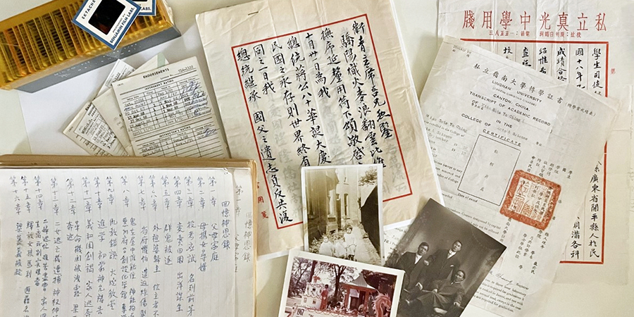
Personal papers

Slide 15
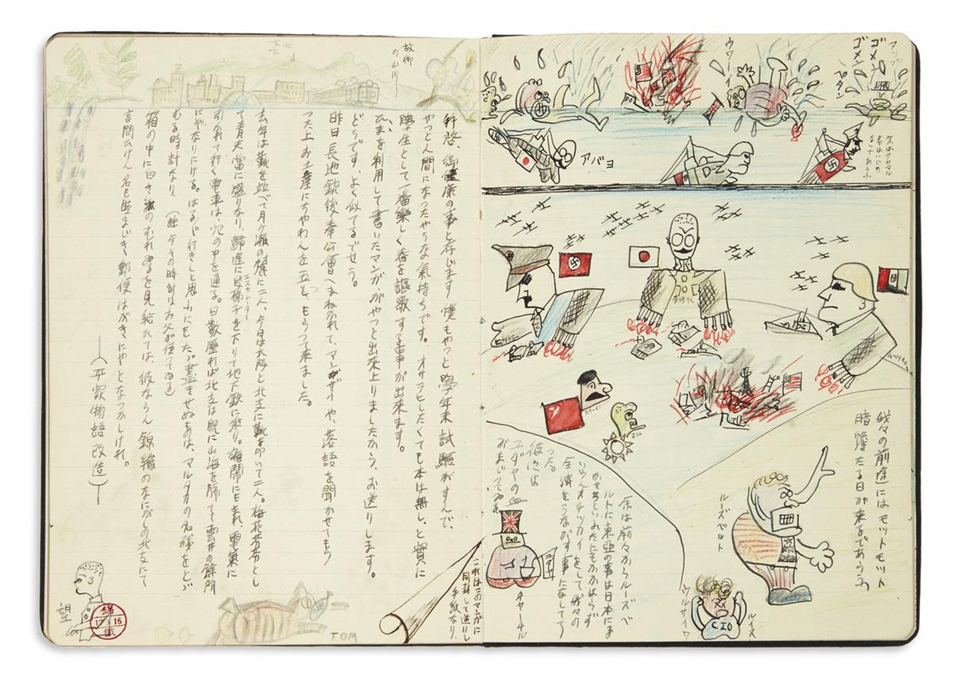
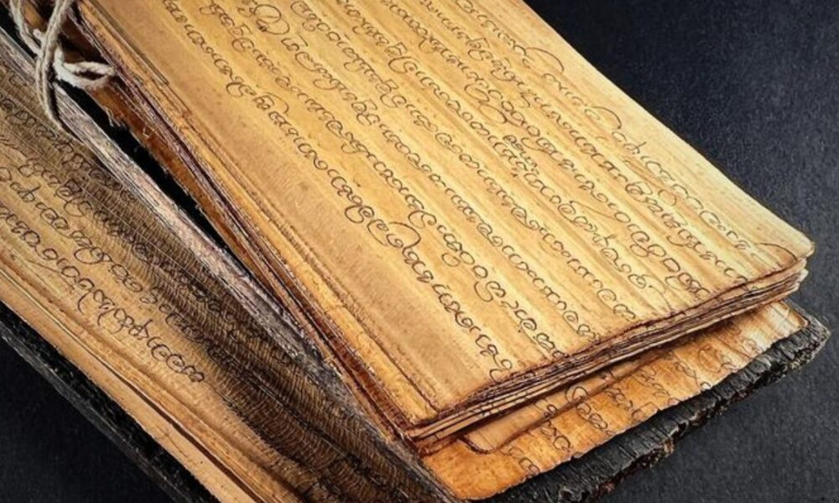
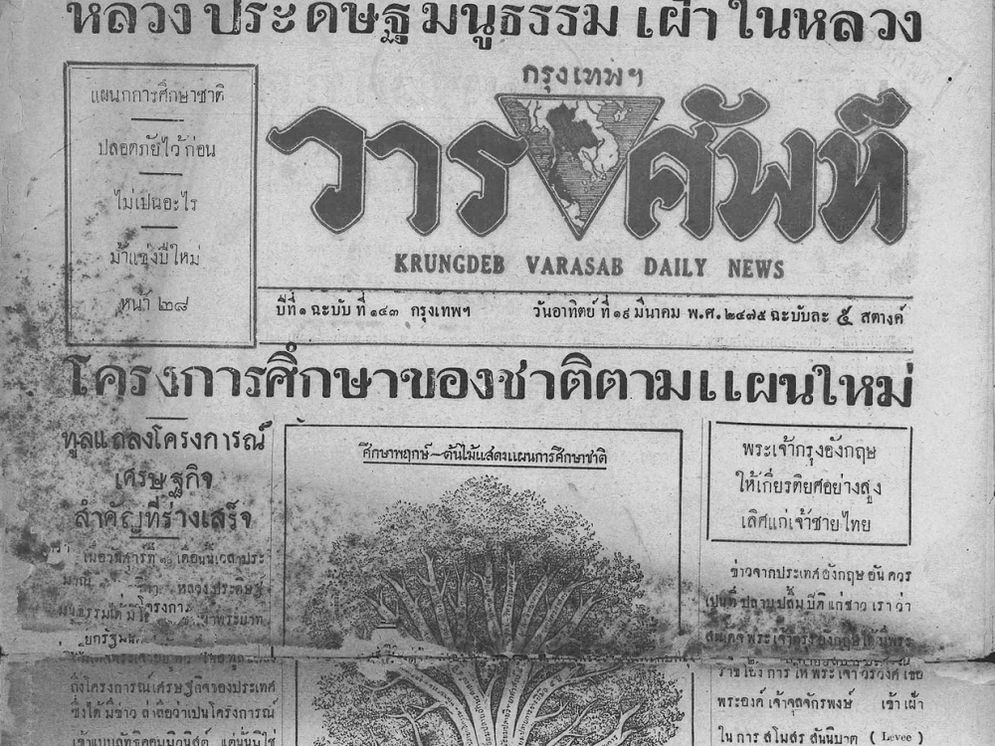
Different forms of ‘original’ archival documents

Slide 16
“The archive, that primary site of state monumentality, is the very institution that canonizes, crystallizes, and classifies the knowledge required by the state even as it makes this knowledge available to subsequent generations in the cultural form of a neutral repository of the past.”
Nicholas B. Dirks, Castes of Mind: Colonialism and the Making of Modern India, 2001

Slide 17
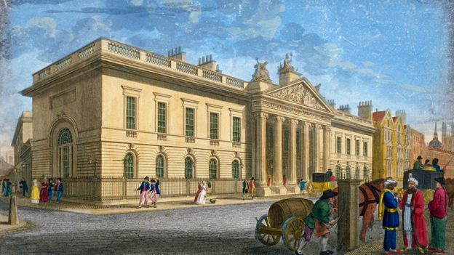
East India Company Headquarters

Slide 18
Community archives…are defined by the active and ongoing involvement of the source community in documenting and making accessible their history on their own terms”

Slide 19
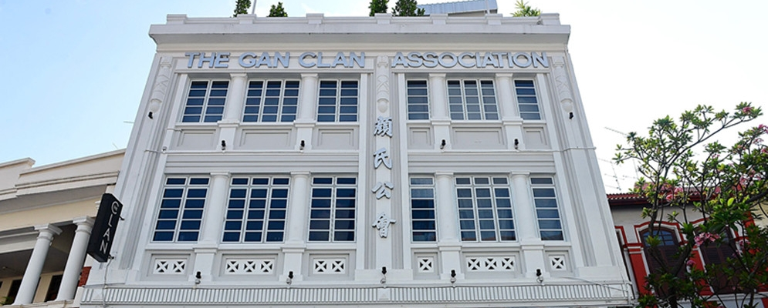
Clan Association Archives

Slide 20
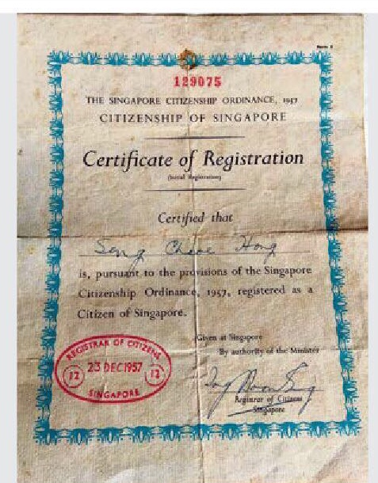
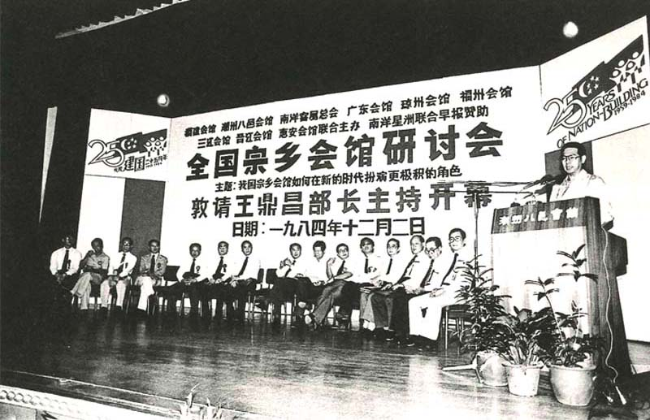
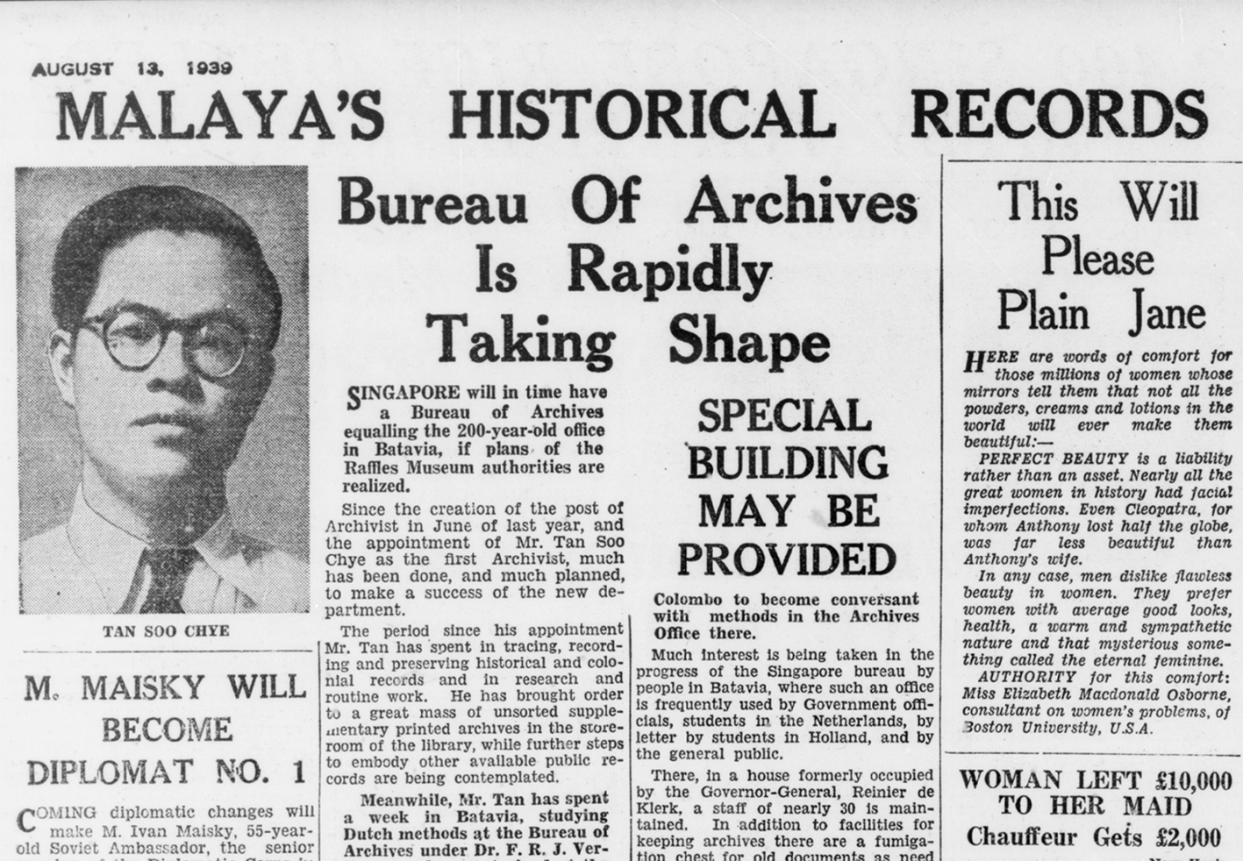
Archives and Identity

Slide 21
The Archival Turn

Slide 22
“Archives need to be read ethnographically every bit as carefully as the documents they house and preserve”
Francis X. Blouin Jr. And William G. Rosenberg, Archives Documentation and Institutions of Social Memory

Slide 23
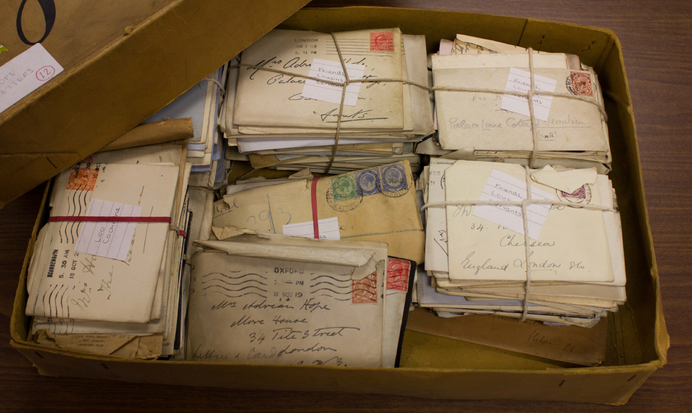
Archives
Reading Archives as “Text”
Archives as sites of memory
Archives inscribe the future; produce what will be remembered (and not)
Archives produce knowledge, legitimise systems, define communities

Slide 24

  Archives
(What do they do?)
Archives define what is knowable and known, by what is preserved and what is not
Archives are sites of concealment and suppression; projection and expression
Silences affect understanding as much as words or pictures create understandings

Slide 25
Source
Analysis
History
Historical context
Archive
Source
Conventional knowledge production process
Archival Turn: Story “behind” the making of a source/narrative; the archive is the product of

Slide 26
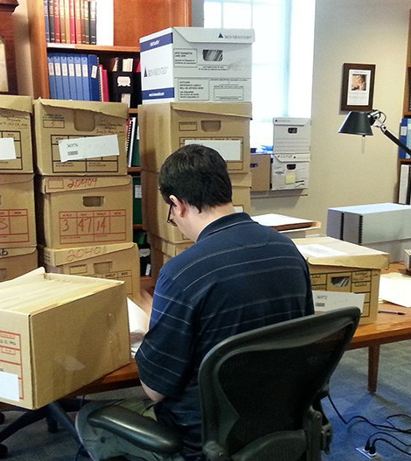
Archival Turn
Cultural Products
Archives as sites with a history and a politics of their own
Archives as products of the individuals and institutions that create and maintain them
Archives as instruments of power to justify authority, legitimacy, and identity

Slide 27
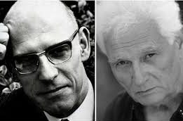
(Archival Turn)
Cultural Products
2 Major thinkers
  Jacques Derrida (1930-2004):
    archive is a site where memory, authority, and power intersect;
    the act of archiving is a political process, shaping the historical narratives that come from it;
    archives remember some things and forget others
Michel Foucault, The Archaeology of Knowledge and the Discourse on Language, 1969
Jacques Derrida “Archive Fever: A Freudian Impression”, 1994

Slide 28
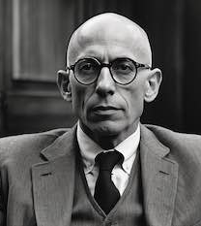
(Archival Turn)
Cultural Products
Michel Foucault (1926-1984)
  Archives refers to the underlying system that governs how knowledge is organized, categorized and made accessible; emphasis on the rules that determine what can be known
  Rules govern how knowledge is produced and exhibited---archives are site where these rules take shape.
  Archive is a system of knowledge production, which is power

Slide 29
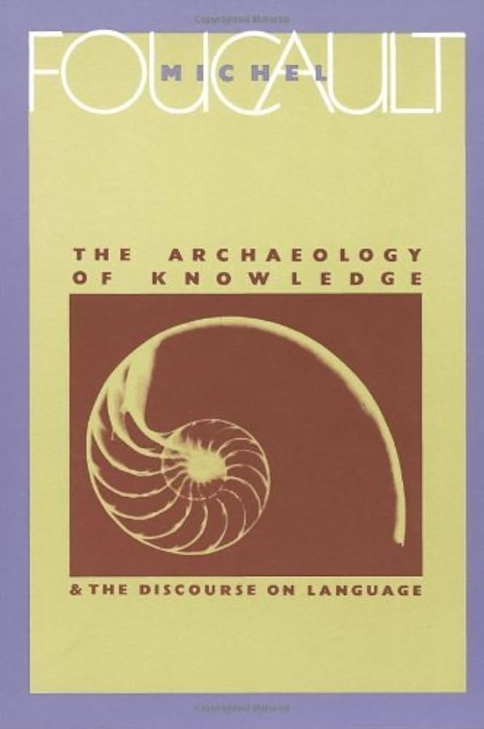
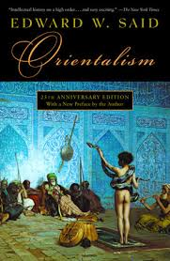

Slide 30
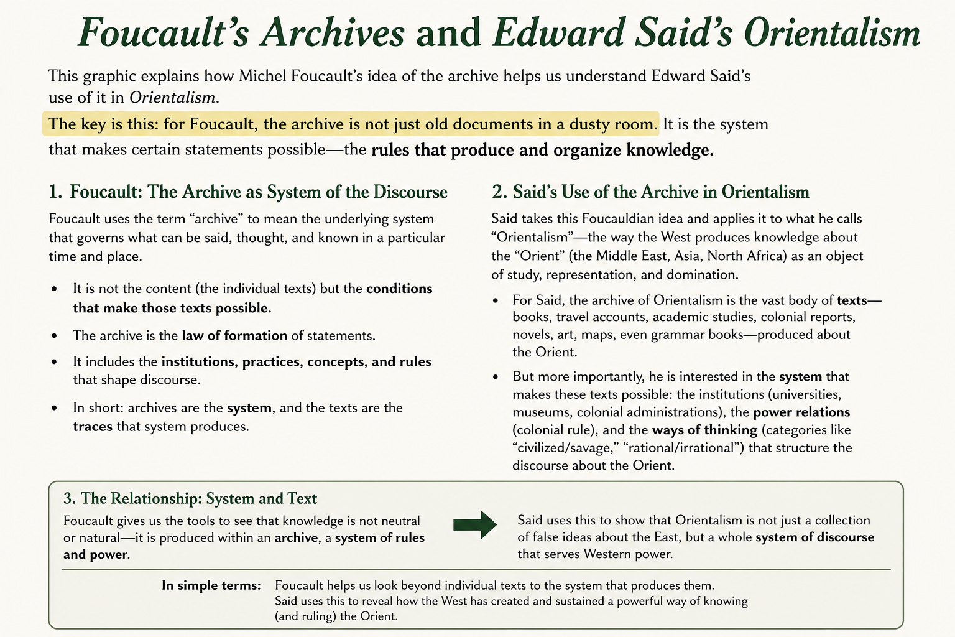

Slide 31
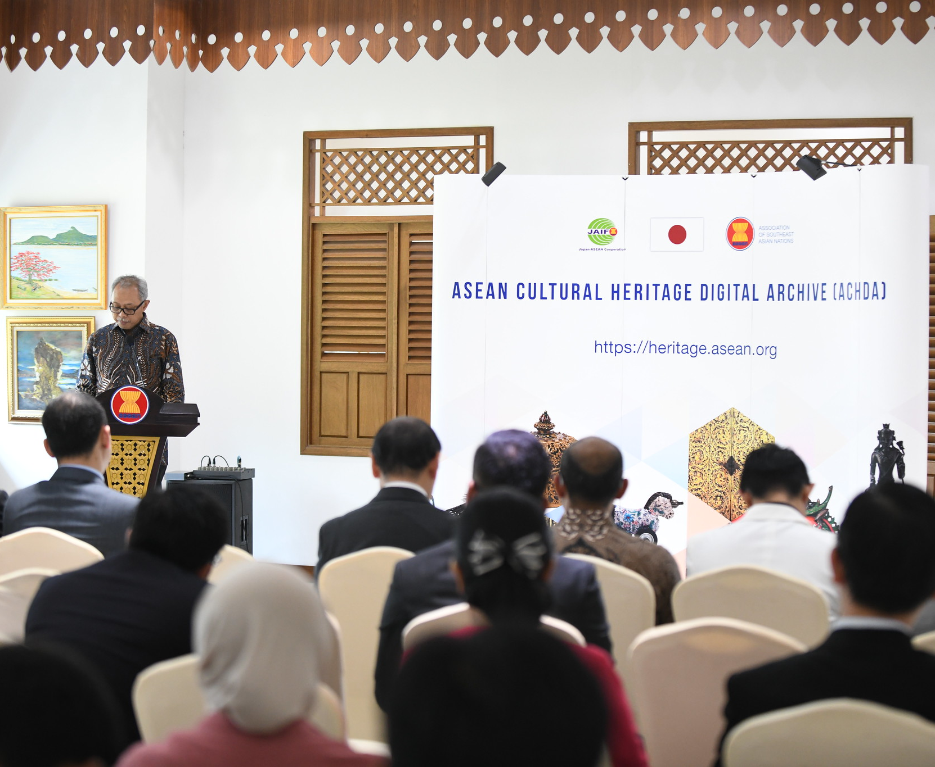
(Archival Turn)
Cultural Products
Implications to Historians
  Historians must question/rethink the archive
  Archives Shape Historical Narratives
  Historians need to “read” what’s missing or silenced
  Archives represent attempts to remember and forget
  What is preserved and why? What political or social circumstances frame how archives are managed?

Slide 32


